Slide 1
CEL and CEA
Best result and its pattern

Slide 2
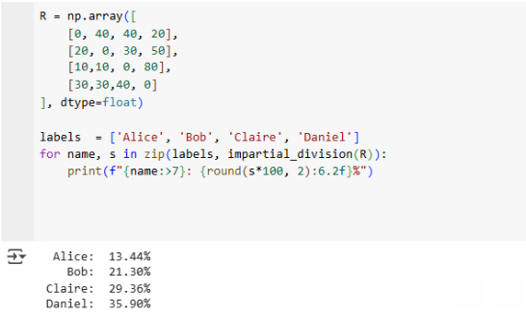
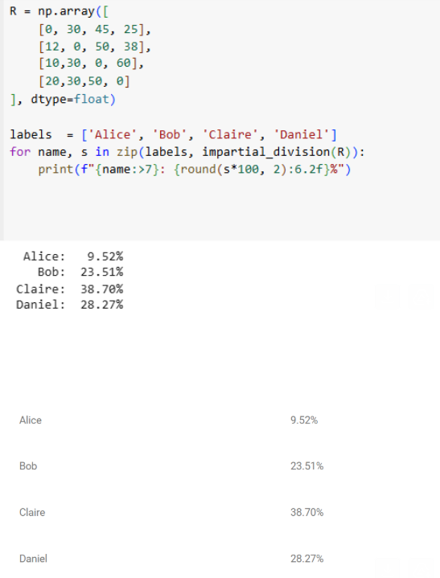
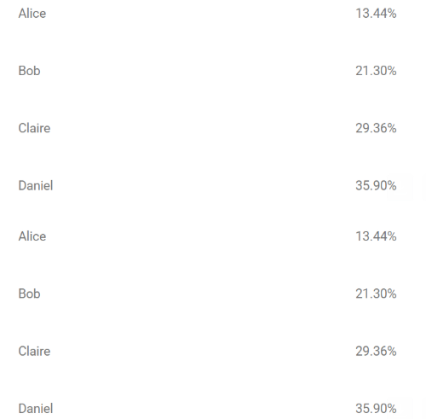
ID should be correct

Slide 3
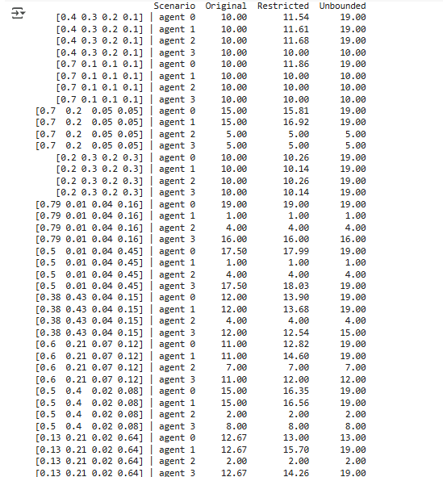
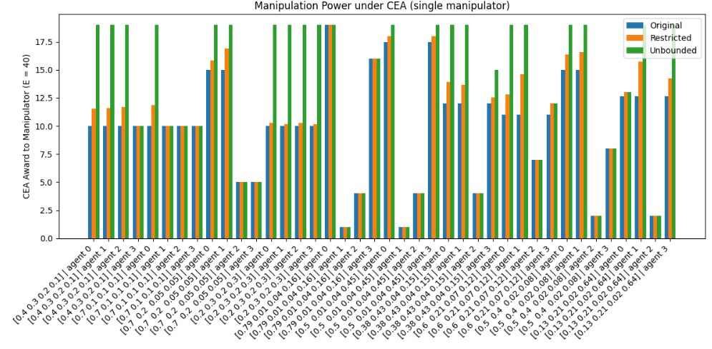
CEA output

Slide 4
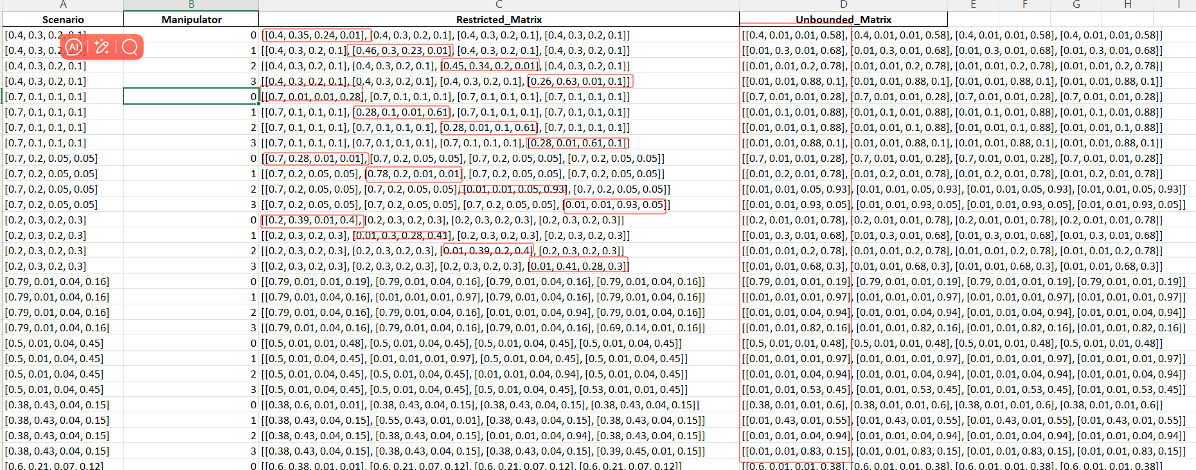
CEA output
Pattern for unbounded: set other agents as 0

Slide 5
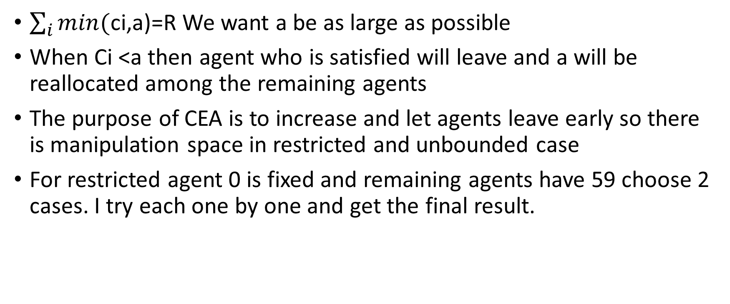
CEA logic
$\sum_{i}{min(}$ci,a)=R We want a be as large as possible
When Ci <a then agent who is satisfied will leave and a will be reallocated among the remaining agents
The purpose of CEA is to increase and let agents leave early so there is manipulation space in restricted and unbounded case
For restricted agent 0 is fixed and remaining agents have 59 choose 2 cases. I try each one by one and get the final result.

Slide 6
For restricted and unbounded
For unbounded, manipulation is more powerful because he can freely reduce other agents' claims drastically. This causes them to drop out immediately at very low cap levels, thus significantly increasing the share of resources left to distribute among the fewer remaining agents.
While restricted case can still reduce the claims of some agents, he can cause certain agents to have lower claims. Agents with lower claims "drop out" earlier

Slide 7
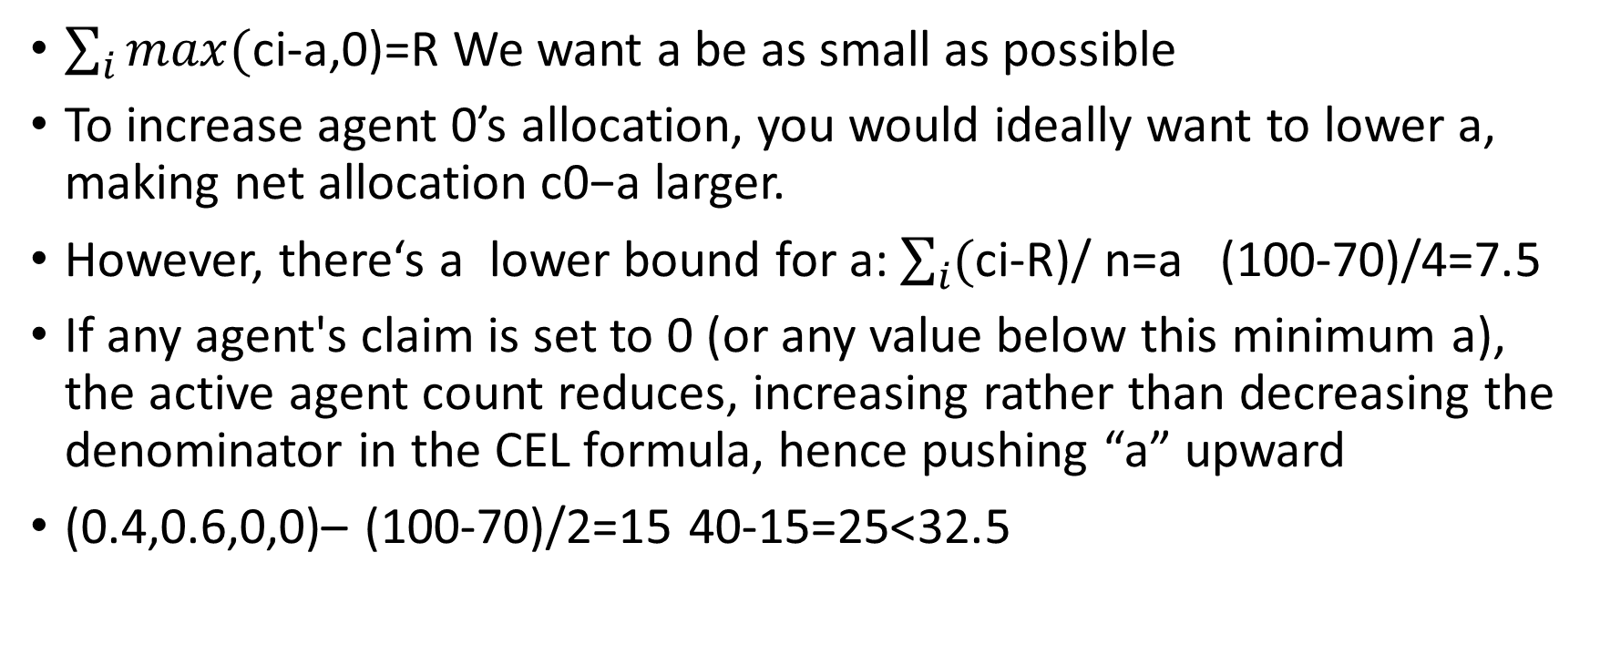
CEL: Why Cannot Improve the Allocation
$\sum_{i}{max(}$ci-a,0)=R We want a be as small as possible
To increase agent 0’s allocation, you would ideally want to lower a, making net allocation c0−a larger.
However, there‘s a lower bound for a: $\sum_{i}{(}$ci-R)/ n=a (100-70)/4=7.5
If any agent's claim is set to 0 (or any value below this minimum a), the active agent count reduces, increasing rather than decreasing the denominator in the CEL formula, hence pushing “a” upward
(0.4,0.6,0,0)– (100-70)/2=15 40-15=25<32.5

Slide 8
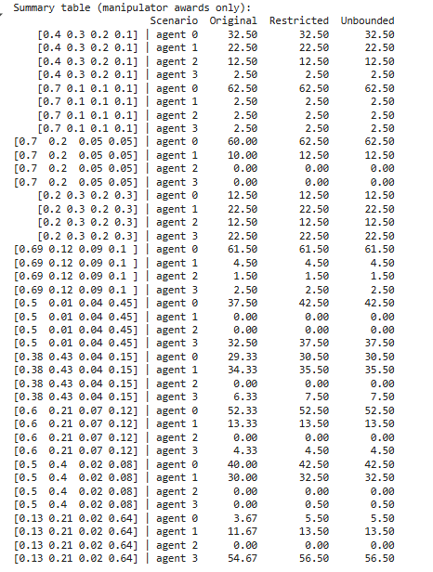
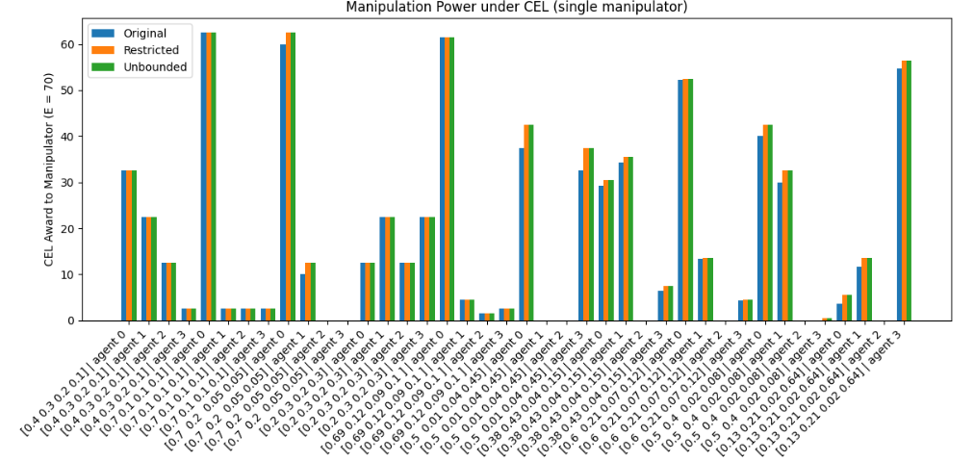
Output for CEL

Slide 9
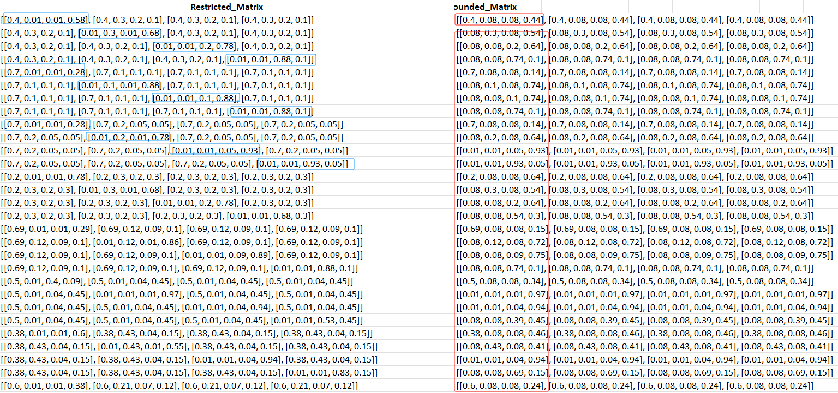
CEL output
Why here set 0.08 as it greater than 0.075. Keep all agents active

Slide 10
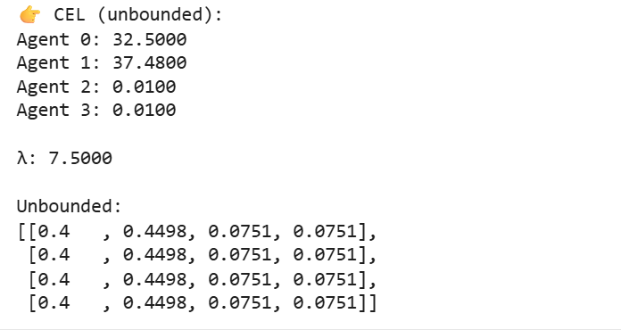
CEL other cases
Does not matter as long as all agents greater than 0.075
restricted (0.40, 0.2275, 0.1525, 0.22)VS unbounded (0.40, 0.08, 0.08, 0.44). Should be same result.

